Slide 1
1st informal consultation workshop on HELCOM and OSPAR underwater noise data upload
Description of the data to be entered in the Noise Register Template
Collection of Data
Quality Assurance
Ben Schmidt – Federal Maritime and Hydrographic Agency (BSH) Germany

Slide 2
Monitoring guidance for underwater sound
The monitoring guidance describes the Parameter entered in the Reporting Template
In the TG Noise, the monitoring guidance for underwater noise is currently being updated
Current gaps in the specification should be passed on to TG Noise to complete guidelines

Slide 3
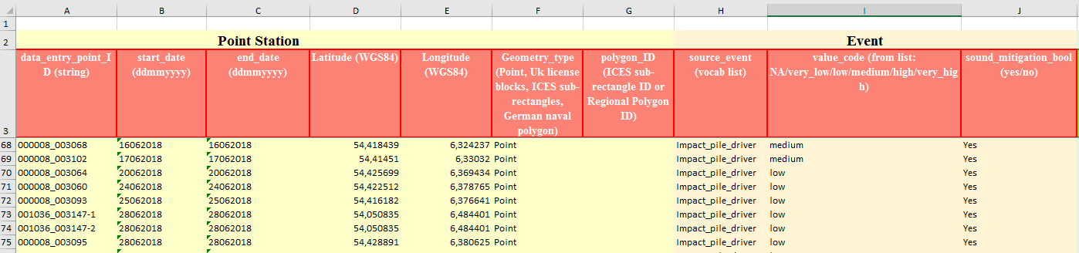
Pile driving – Mandatory Information
UUID to assign sound events uniquely
The UUID can be used to correct or complete a previously made data delivery
If parameters reported in this table change during pile driving, the event should be split and the UUID should be extended by the characters "-1" and "-2", respectively.

Slide 4
Pile driving – Mandatory Information
Start and end date of the event in UTC
In the Holas Assessment, if a sound event is present, the entire day is considered to be polluted
Hammerlogs and ramming protocols often are in Local time

Slide 5
Pile driving – Mandatory Information
Coordinates of the event in the WGS84-Coordinate System – Only to be filled in if “Geometry_type” is “Point”
Make sure that the coordinates of each event are not on land and that Latitude and Longitude are not mixed up.

Slide 6
Pile driving – Mandatory Information
Position specification format
Fill in "Point" if the coordinates of the event are known
Fill in "ICES subrectangles" if no exact coordinate can be specified for the event

Slide 7
Pile driving – Mandatory Information
Area in which the event took place
Not to be filled in if “Geometry_type” is “Point”

Slide 8
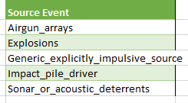
Pile driving – Mandatory Information
Type of Event
For Pile driving choose “Impact_pile_driver”

Slide 9
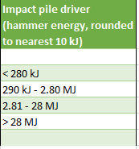

Pile driving – Mandatory Information
Volume Category
The classification differs for different “source_event”
For pile driving the maximum applied energy per Ramming stroke is used
This usually does not match the maximum possible energy of the pile driving hammer
Fill in “NA” if the maximum applied energy is unknown

Slide 10
Pile driving – Mandatory Information
Use of secondary sound mitigation systems
Fill in “Yes” if they were used, otherwise fill in “No”
Techniques to reduce the source level count as primary sound mitigation and not as secondary sound mitigation and are therefore not to be reported

Slide 11
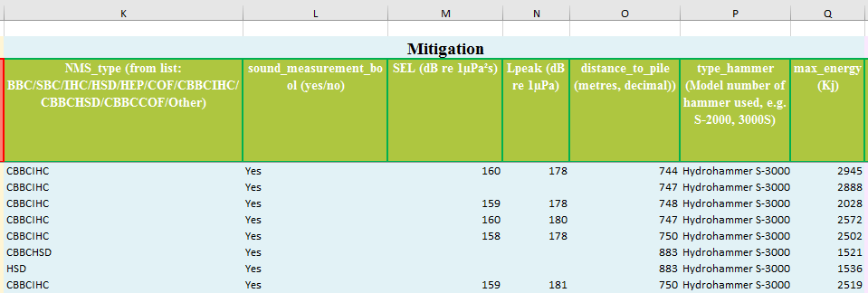
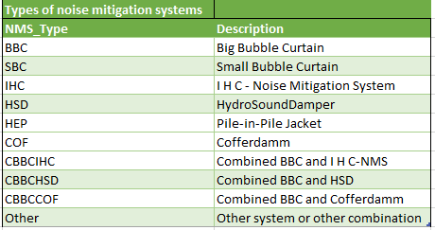
Pile driving – Information on Mitigation
Code of secondary noise mitigation system used

Slide 12
Pile driving – Information on Mitigation
Application of sound measurements with calibrated hydrophones
Fill in "Yes" if sound measurements have been made, otherwise fill in "No".

Slide 13
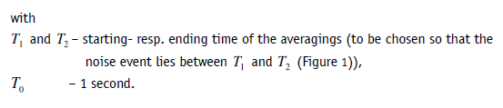



Pile driving – Information on Mitigation
Measured Sound Exposure Level
Germany reports the 5% Exceedence Level is reported

Slide 14


Pile driving – Information on Mitigation
Measured zero-to-peak Sound Pressure Level

Slide 15
Pile driving – Information on Mitigation
Distance at which the sound measurements took place
In Germany, the preferred measuring distance is 750 m

Slide 16
Pile driving – Information on Mitigation
Hammer type used

Slide 17
Pile driving – Information on Mitigation
Maximum applied energy per ramming stroke
Used for the determination of the “value_code”

Slide 18
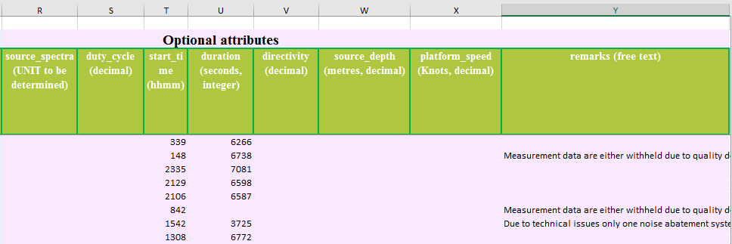
Pile driving – Optional attributes
currently not used
Format has to be specified in Monitoring guidance by TG Noise

Slide 19
Pile driving – Optional attributes
Not relevant for pile driving

Slide 20
Pile driving – Optional attributes
Start time of the event
7:35 AM = 0735
10:30 PM = 2230

Slide 21
Pile driving – Optional attributes
Duration of the event
Breaks during the pile driving are not included

Slide 22
Pile driving – Optional attributes
Comments that may be helpful for the evaluation of the data

Slide 23
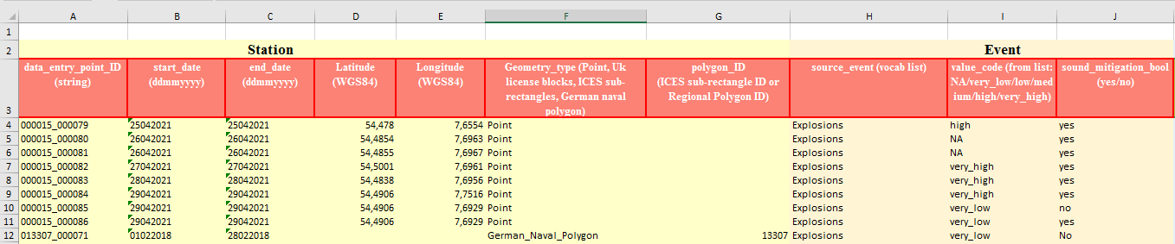
Explosions – Mandatory Information
UUID to assign sound events uniquely
The UUID can be used to correct or complete a previously made data delivery
If for reports from the military only the information is available in which month how many explosions took place within an area, then one UUID can be used for all explosions together and the number of explosions can be specified in the comment field

Slide 24
Explosions – Mandatory Information
Start and end date of the event in UTC
Since explosions are very short events both dates should be equal
An exception are reports of the military, here the start and end date of the month is entered, if only the month in which the explosion occurred is known
How to deal with the resulting overestimation in the HOLAS assessment remains to be clarified

Slide 25
Explosions – Mandatory Information
Coordinates of the event in the WGS84-Coordinate System – Only to be filled in if “Geometry_type” is “Point”
Make sure that the coordinates of each event are not on land and that Latitude and Longitude are not mixed up.

Slide 26
Explosions – Mandatory Information
Position specification format
Fill in "Point" if the coordinates of the event are known
Fill in "ICES SubRectangle" if no exact coordinate can be specified for the event
Regional polygons can be set up for reporting military activities with reduced temporal and spatial resolution

Slide 27
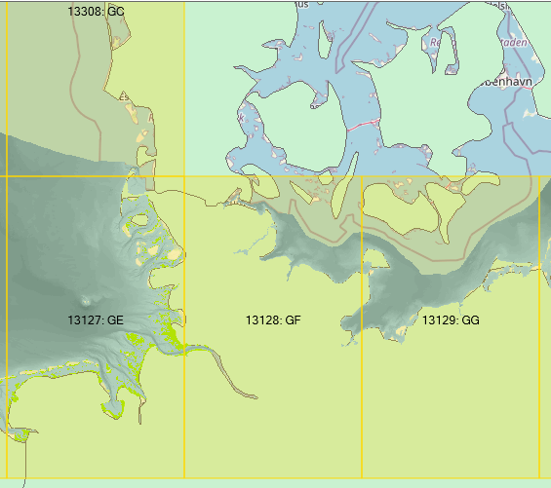
Explosions – Mandatory Information
Area in which the event took place
Not to be filled in if “Geometry_type” is “Point”
German Naval Polygons

Slide 28
Explosions – Mandatory Information
Type of Event
For Explosions choose “Explosions”

Slide 29
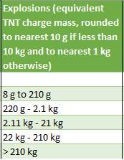
Explosions – Mandatory Information
Volume Category
The classification differs for different “source_event”
For explosions the TNT equivalent is used
There is a new classification approach using a magnitude
This will be presented later

Slide 30
Explosions – Mandatory Information
Use of secondary sound mitigation systems
Fill in “Yes” if they were used, otherwise fill in “No”

Slide 31
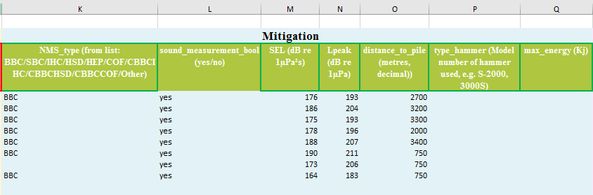
Explosions – Information on Mitigation
Code of secondary noise mitigation system used
Currently, BBC are the only applicable sound mitigation systems for explosions.

Slide 32
Explosions – Information on Mitigation
Analog to Pile driving

Slide 33
Explosions – Information on Mitigation
Not relevant for Explosions

Slide 34
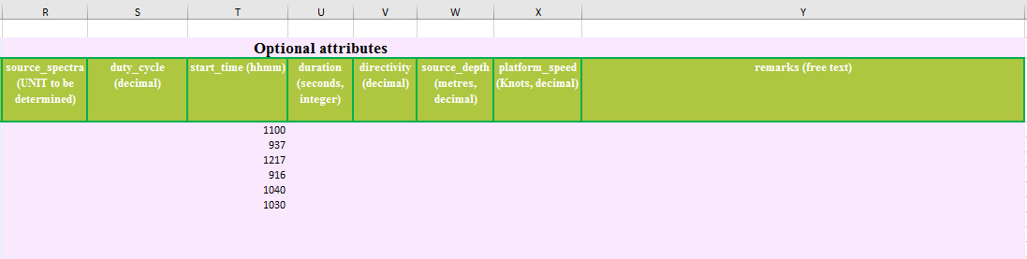
Pile driving – Optional attributes
currently not used
Format has to be specified in Monitoring guidance by TG Noise

Slide 35
Pile driving – Optional attributes
Not relevant for explosions

Slide 36
Pile driving – Optional attributes
Analog to Pile driving

Slide 37
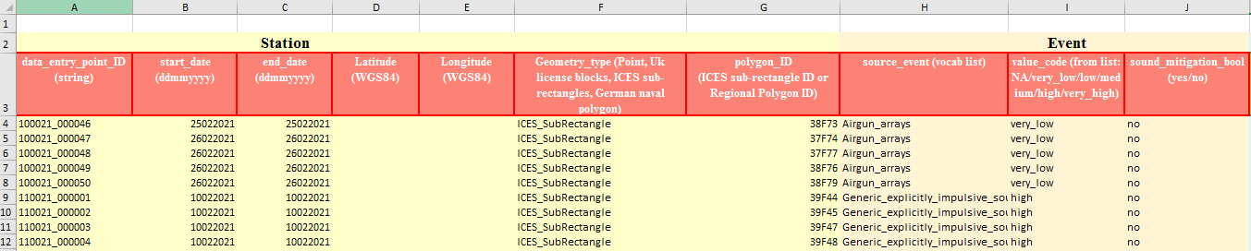
Seismic survays – Mandatory Information
UUID to assign sound events uniquely
The UUID can be used to correct or complete a previously made data delivery
Specify for the ICES sub-rectangles the time periods during which seismic survays took place
Use one UUID for each combination of time period and source event
Don’t report every shot of a seismic survey as a single event
This drastically increases the number of reported events and hinders the later Holas Assessement

Slide 38
Seismic survays – Mandatory Information
Start and end date of a seismic survey within an ICES sub-rectangle in UTC

Slide 39
Seismic survays – Mandatory Information
Not relevant for seismic survays

Slide 40
Seismic survays – Mandatory Information
Position specification format
Fill in "ICES SubRectangle" for seismic survays

Slide 41
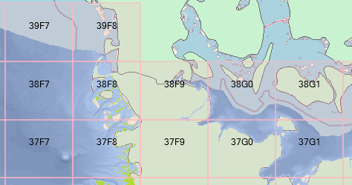
Seismic survays – Mandatory Information
Area in which the event took place
The definition of ICES Sub-Rectangles is described at the ICES website https://www.ices.dk/data/maps/Pages/ICES-statistical-rectangles.aspx
In the above example, only ICES Rectangles were specified, which have a lower resolution
ICES Rectangles

Slide 42
Seismic survays – Mandatory Information
Type of Event
For Airguns fill in “Airgun_arrays”
For other seismic sources such as Sparker, Boomer and Sub-bottom profiler, fill in “Generic_explicitly_impulsive_source”

Slide 43
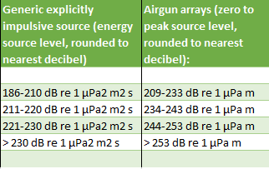
Seismic survays – Mandatory Information
Volume Category
The classification differs for different “source_event”
For Airguns the zero to peak source level at 1m distance is used
For other seismic sources the energy source level is used

Slide 44
Seismic survays – Mandatory Information
Use of secondary sound mitigation systems
Generally, sound mitigation systems are not used for seismic survays

Slide 45
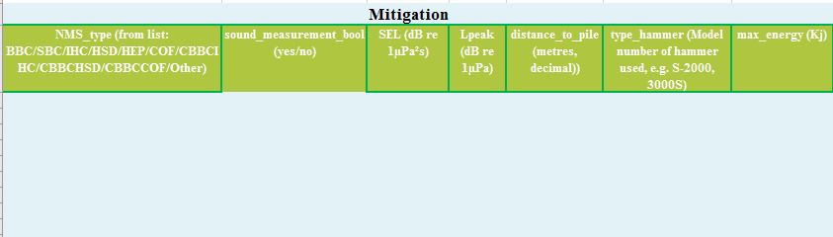
Seismic survays – Information on Mitigation
Not relevant for seismic survays

Slide 46
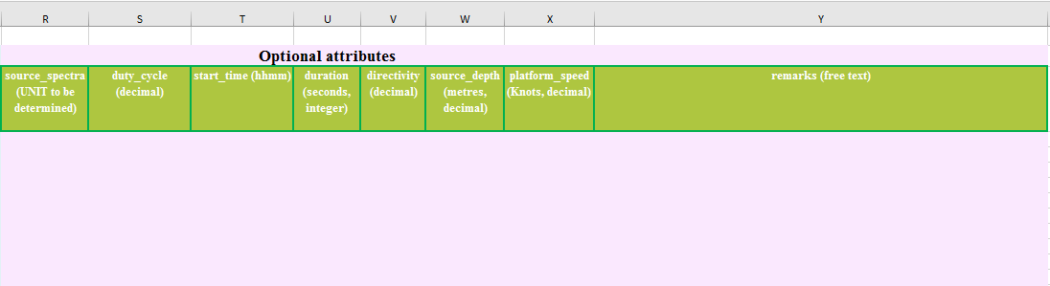
Seismic survays – Optional attributes
currently not used
Format has to be specified in Monitoring guidance by TG Noise

Slide 47
Seismic survays – Optional attributes
Time at which seismic survey started or alternatively time at witch ship entered the ICES Sub Rectangle

Slide 48
Seismic survays – Optional attributes
Duration of the seismic survey in this ICES rectangle in the specified time interval

Slide 49
Seismic survays – Optional attributes
Depth of the seismic source relative to the sea surface

Slide 50
Seismic survays – Optional attributes
Speed of the ship

Slide 51
Seismic survays – Optional attributes
Analog to pile driving

Slide 52
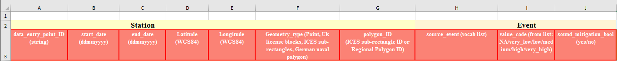
Sonar or acoustic deterrents – Mandatory Information
Analog to Explosions

Slide 53
Sonar or acoustic deterrents – Mandatory Information
Type of Event
Fill in “Sonar_or_acoustic_deterrents”

Slide 54
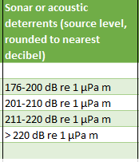
Sonar or acoustic deterrents – Mandatory Information
Volume Category
The classification differs for different “source_event”
For Sonar or acoustic deterrents the source level at 1m distance is used

Slide 55
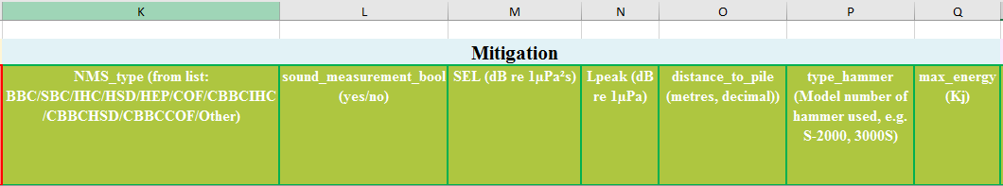
Sonar or acoustic deterrents – Information on Mitigation
Not relevant for sonar or acoustic deterrents

Slide 56
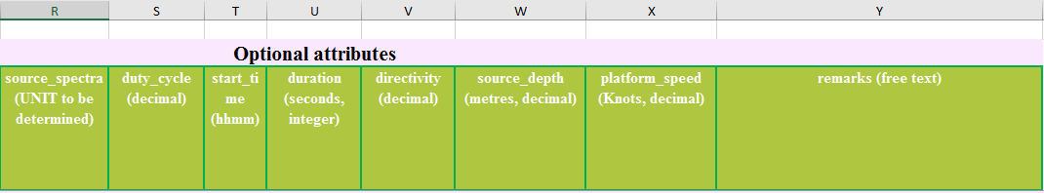
Sonar or acoustic deterrents – Optional attributes
currently not used
Format has to be specified in Monitoring guidance by TG Noise

Slide 57
Sonar or acoustic deterrents – Optional attributes
Analog to pile driving

Slide 58
Sonar or acoustic deterrents – Optional attributes
Analog to seismic survays

Slide 59
Collection of data in Germany
Sound events of the coastal waters are reported to the BSH by the responsible persons of the coastal federal states.
Pile driving: BSH is the approval authority responsible for the EEZ and receives detailed documentation via the technical information system MarinEARS
Explosions: The BSH is reported explosions by the military and explosions in the context of construction activities; as far as we know, there are no other explosions in the EEZ.
Seismic: Research actions approved by the BSH are reported; research actions not requiring approval of BSH are sometimes reported to BSH on a voluntary basis

Slide 60
Quality Assurance in Germany
Sound events submitted via MarinEARS are compared to the piling protocols and discrepancies are corrected
The reporting template is exported from MarinEARS and checked for correctness before delivery to ICES
Common errors
Conversion from local time to UTC
Interchange of Lat/Lon
Coordinates are on the land
For Pile driving the specification of the noise mitigation systems

